Slide 1




What's New in Microsoft Entra ID September 2023
Grace Picking
Jorge Lopez

Slide 2
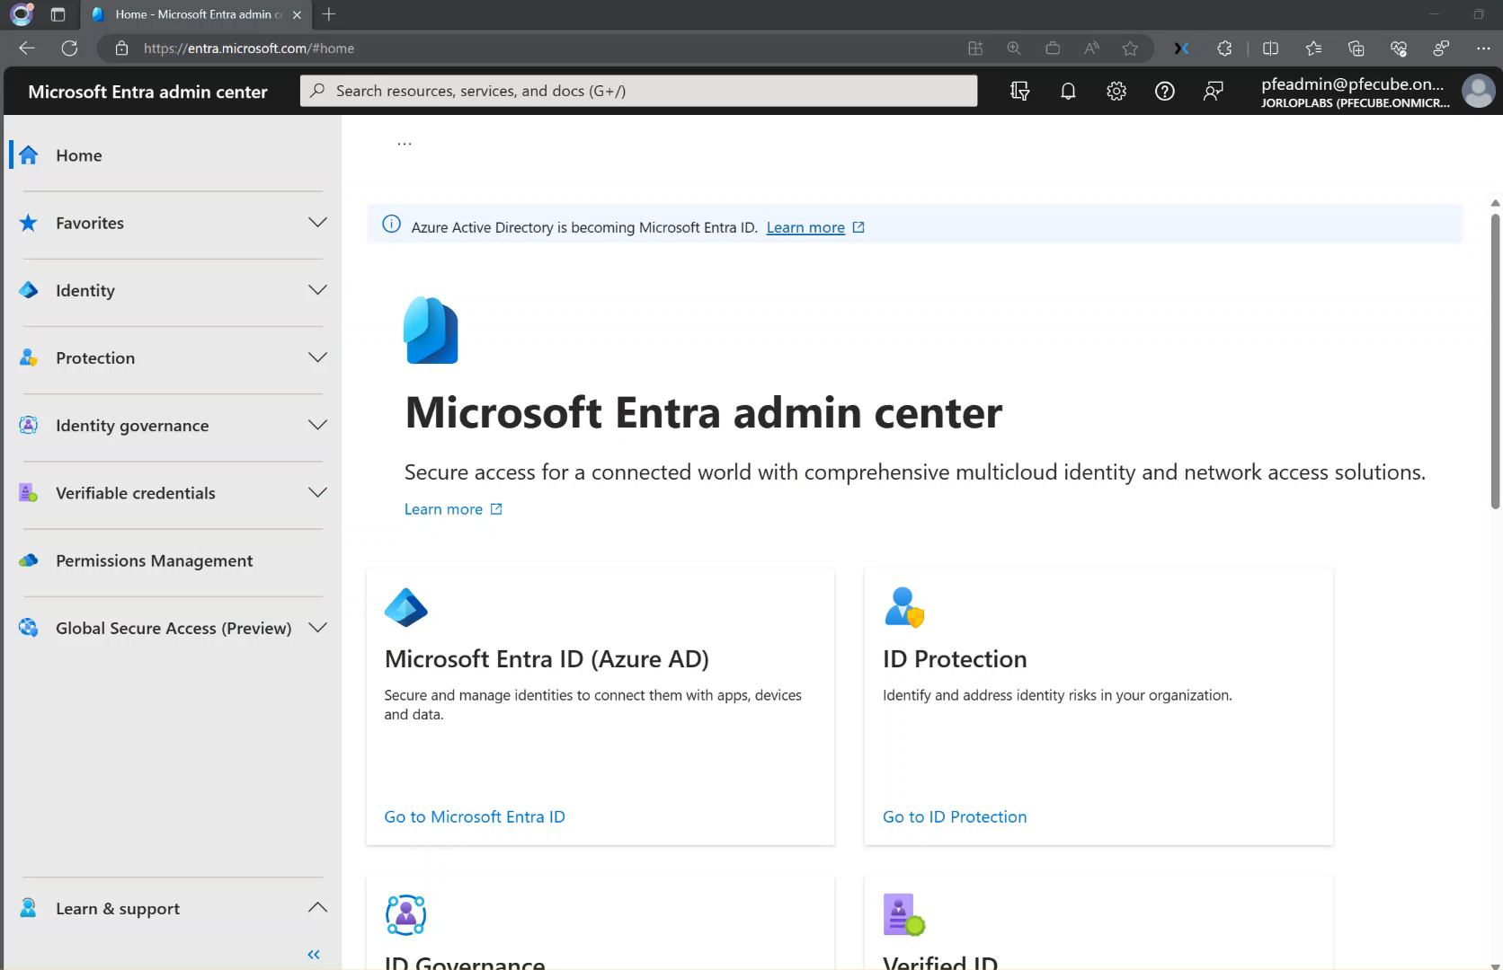
Conditional Access for protected Actions
Stage : GA Product family : Microsoft Entra ID
Overview : Protected actions refer to high-stakes operations that carry significant risk, such as altering conditional access policies, adding credentials to an application, or changing federation trust settings. These actions, if executed by a malicious actor, can severely compromise your organization's security posture.
https://aka.ms/425show/CAprotectedActions

Slide 3
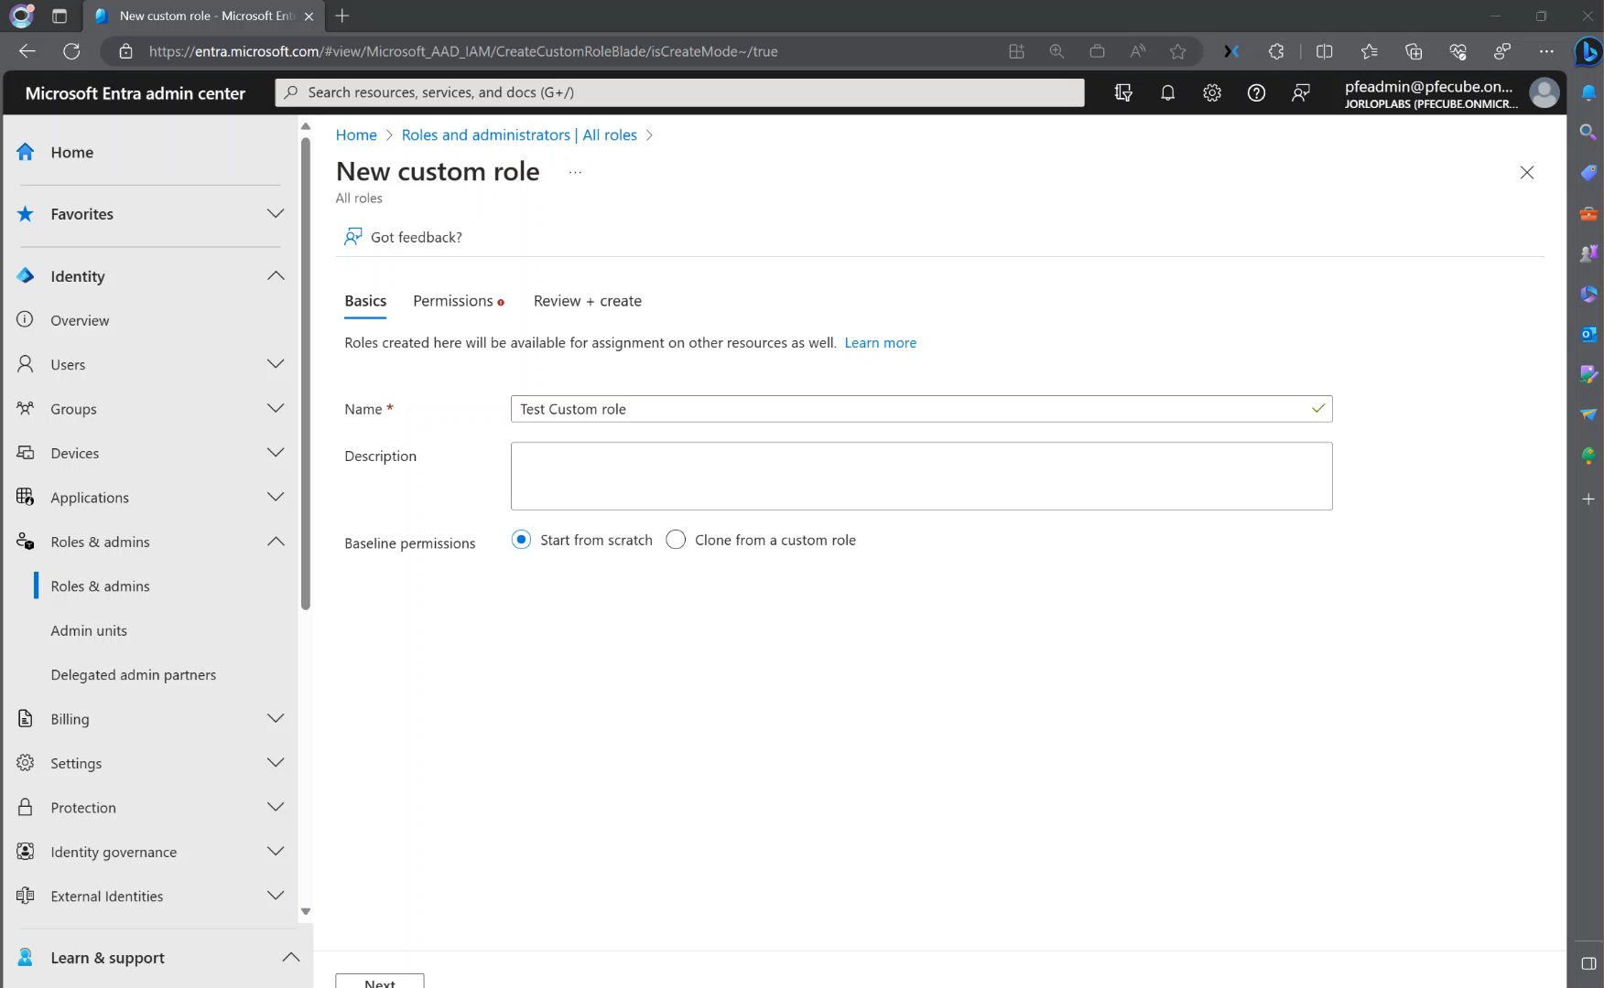
Cross-tenant access settings for custom roles and protected actions
Stage : GA Product family : Microsoft Entra ID
Overview : Cross-tenant access settings can be managed with custom roles enabling you to define your own finely-scoped roles to manage cross-tenant access settings instead of using one of the built-in roles.
Also, you can now protect privileged actions inside of cross-tenant access settings using Conditional Access
https://aka.ms/425show/xtapcustomroles

Slide 4
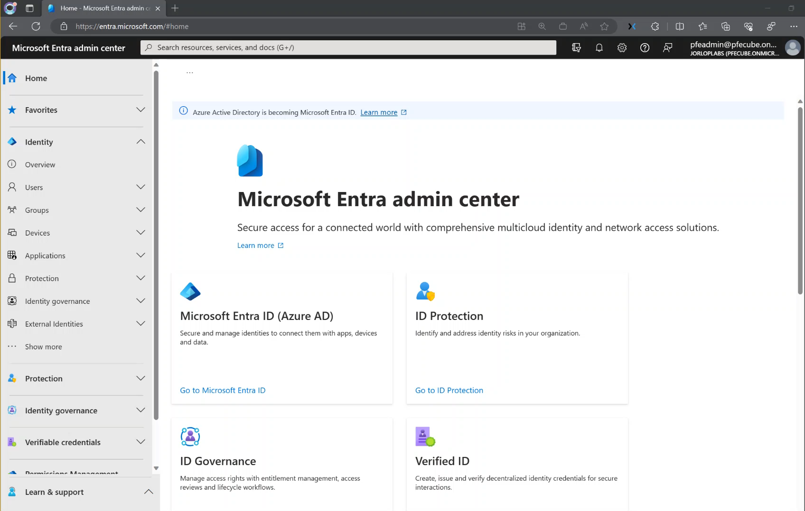
Cross-tenant access settings for B2B collaboration improvements
Stage : GA Product family : Microsoft Entra ID
Overview Microsoft Entra ID now also checks cross-tenant access settings in addition to the current allow or block lists at invitation time for Microsoft Entra ID based domains.
This integration improves the 25 KB limitation of allow or deny lists by adding more capacity across both policies and improves the end user experience by preventing invitations from being sent which would otherwise fail
https://aka.ms/425show/B2Ballowdenylist

Slide 5
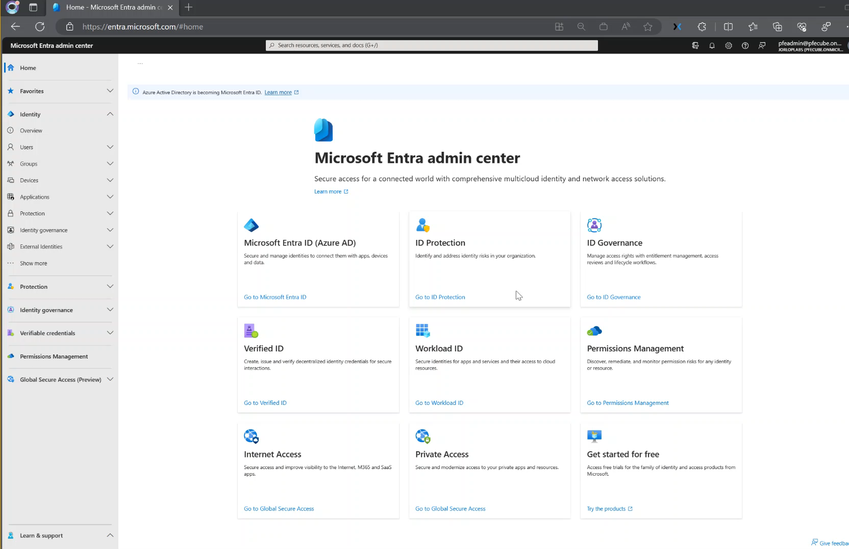
Authentication plane Tenant Restrictions (TRv2)
Stage : GA
Product family: Microsoft Entra ID
Overview : Tenant restrictions, part of cross-tenant access settings, allows administrators to control which external apps your external accounts can or cannot access from the organization's devices and networks. This can be scoped by app, group, and user on a per-external-tenant basis.
https://aka.ms/425show/TRV2

Slide 6
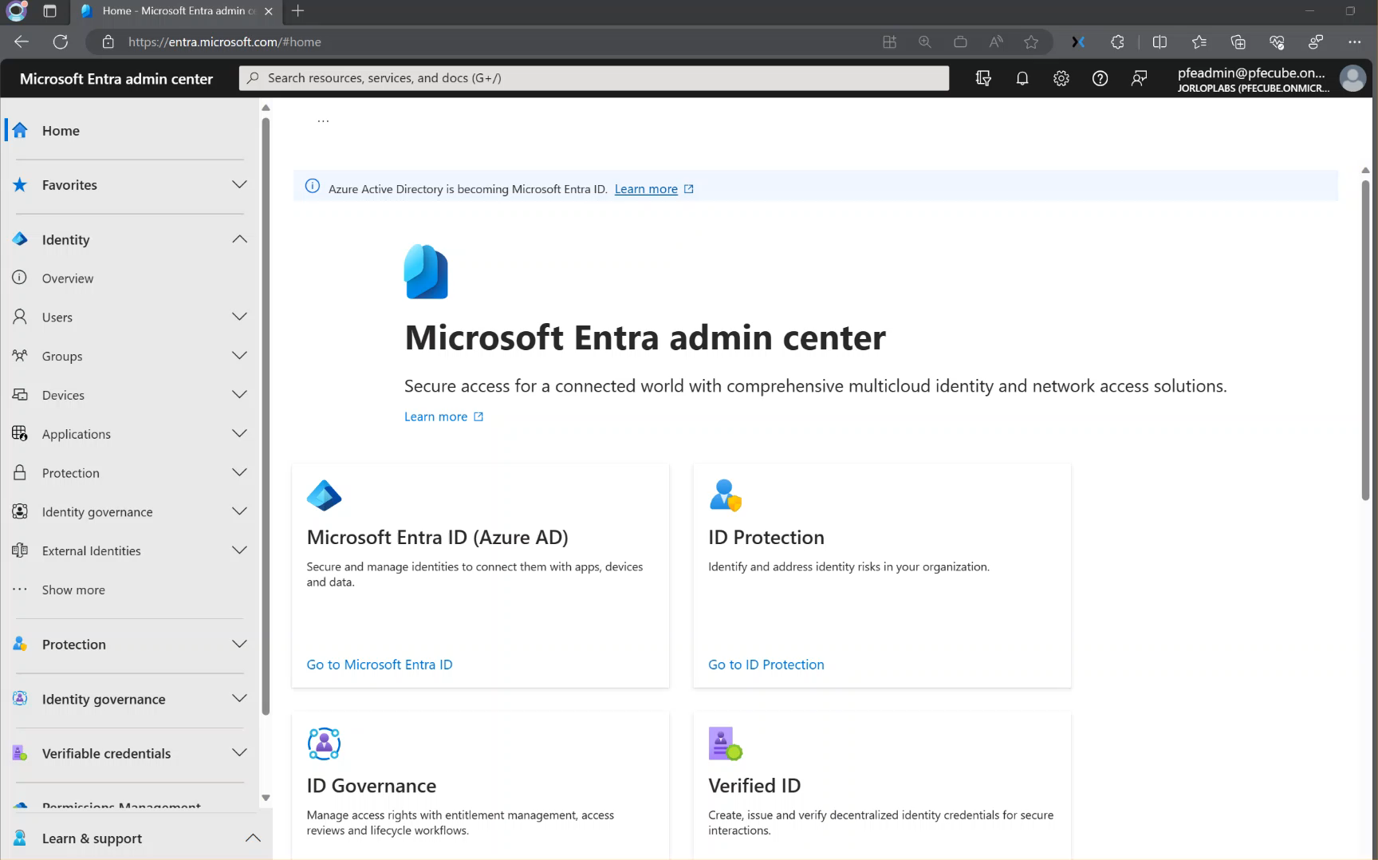
Enhancements to All Users and User profile
Stage : GA Product family : Microsoft Entra ID
Overview : The All Users list has been modernized, shifting from a page to an infinite scroll view.
The User Profile page is now responsive to RBAC, showing different feed cards based on the permissions that an admin has. The Properties tab has been expanded to include nearly all the user properties exposed in Microsoft Graph, including extension attributes

Slide 7
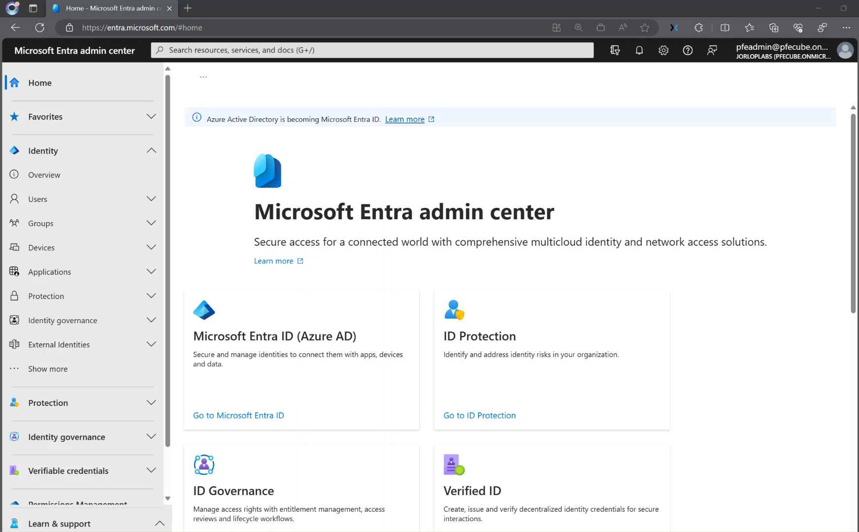
Enhancements to create User and Invite user
Stage : GA Product family : Microsoft Entra ID
Overview : The number of properties admins can define when creating and inviting a user in the Microsoft Entra admin portal has been increased, bringing our UX to parity with our Create User Microsoft Graph API.
Additionally, admins can now add users to a group or administrative unit and assign roles.

Slide 8

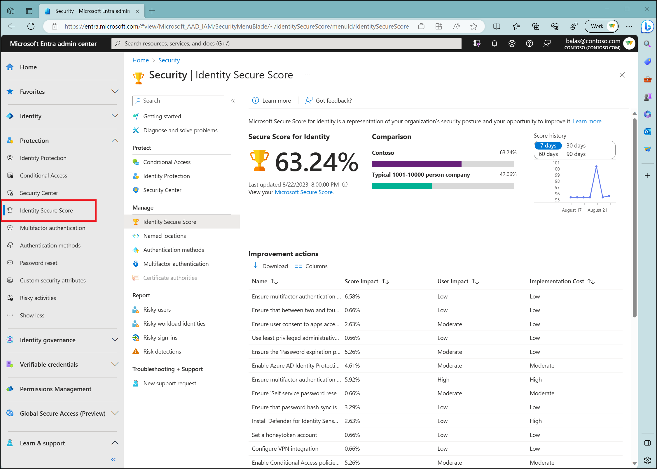
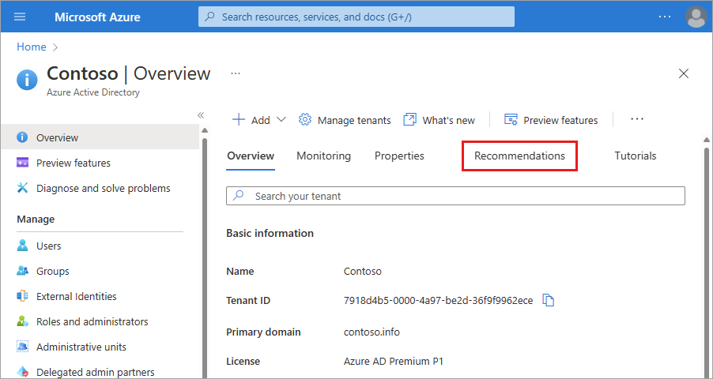
Identity secure Score in Microsoft Entra recommendations
Stage : Public Preview
Product family : Microsoft Entra ID
Overview : – Integrates Identity Secure Score into Microsoft Entra recommendations consolidating all these best practices in a single place.

Slide 9
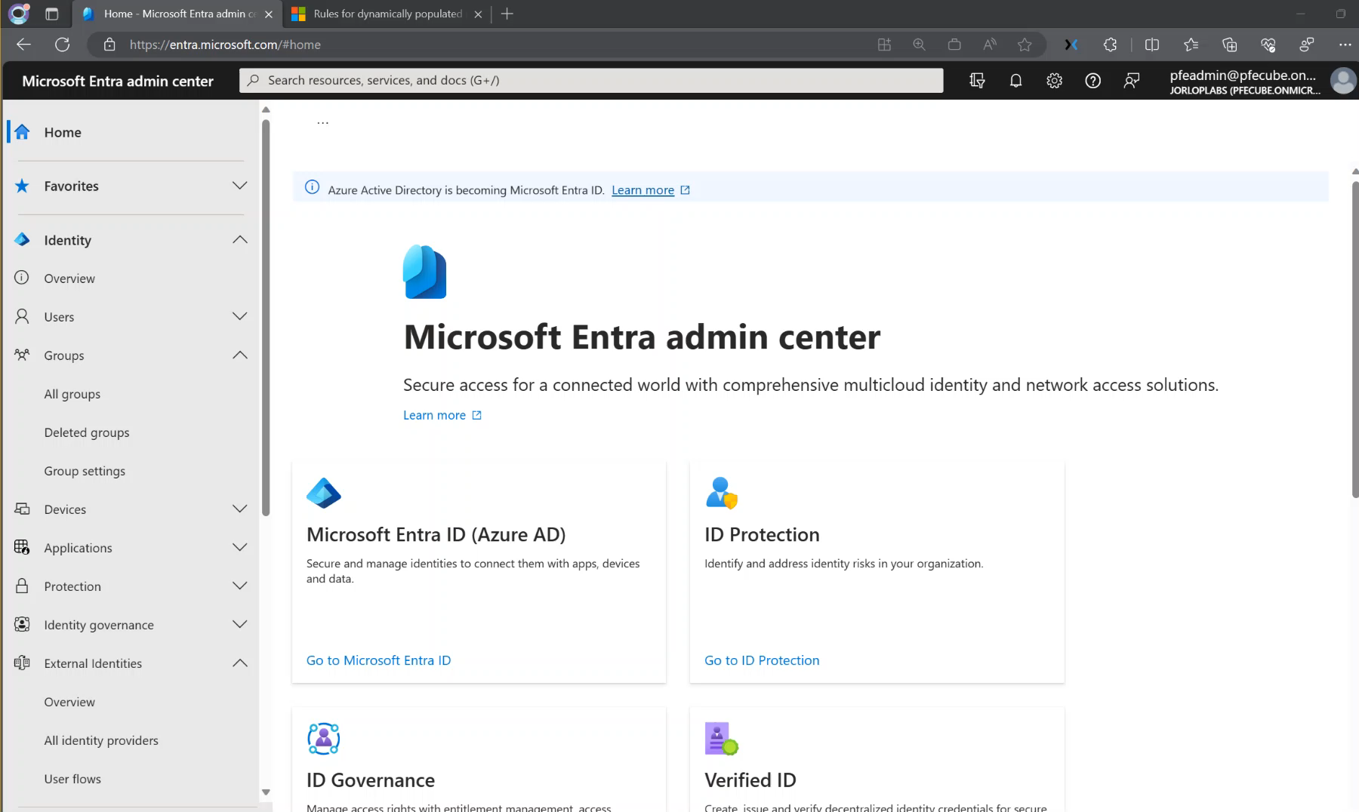
Time-based rules for dynamic groups and dynamic administrative units
Stage : Public Preview
Product family : Microsoft Entra ID
Overview : The dynamic group service now enables admins to create dynamic groups and administrative units based on the employeeHireDate attribute.
This new functionality enables grouping employees together based on their start date, addressing scenarios such as sending onboarding communication to new hires on their first day, week, or month, or communicating with tenured employees on their work anniversaries.

Slide 10
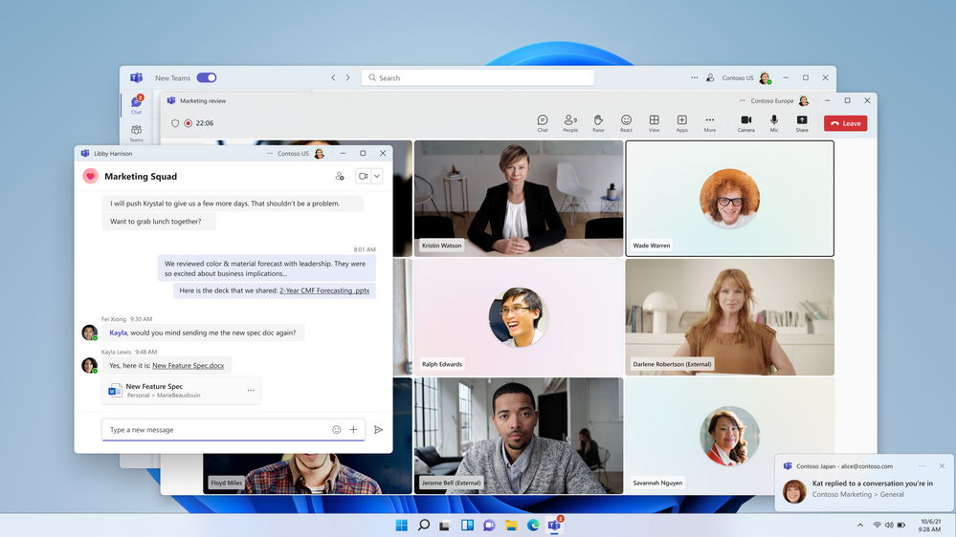
Multi-tenant collaboration for Microsoft Teams
Stage : Public Preview
Overview : When admins have configured a multi-tenant organization (MTO) group in the Microsoft 365 admin center and when their employees are using the new Teams desktop client, these new MTO features help deliver rich multi-tenant collaboration experiences across search, chat, calling, meetings, and content sharing, while eliminating silos and bringing users together across tenant boundaries.
https://aka.ms/425show/TeamsMTO

Slide 11
Thank you for tuning in!
Don’t forget to tune in again for the September updates on October!
Grace Picking
Jorge Lopez

